Slide 1
Flashback to VIRUSES!
What do viruses need to reproduce?
Other viruses
Host organisms
A nutrient medium
An enzyme solution
Which characteristic do viruses possess in common with living cells?
They contain a nucleus and organelles.
They make their own food.
They contain nucleic acids such as DNA or RNA.
They respond to their environment.

Slide 2
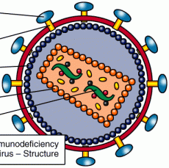
Hi! My name is Baxter E. O. Phage!
And I’m H. Ivy! And this is…
How Viruses take over your cell’s ribosomes to make more viruses!
http://www.youtube.com/watch?v=jufxsH3fQY0

Slide 3
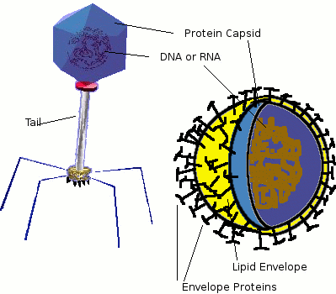
Review: What do viruses look like?
May contain DNA or RNA (nucleic acids), but not both.
The nucleic acids are surrounded by a capsid, which is made of proteins.
Viruses have small structures made of protein on their surface to help them attach to a host cell.

Slide 4
How do viruses replicate??
The virus can either replicate by the lytic cycle or the lysogenic cycle.

Slide 5
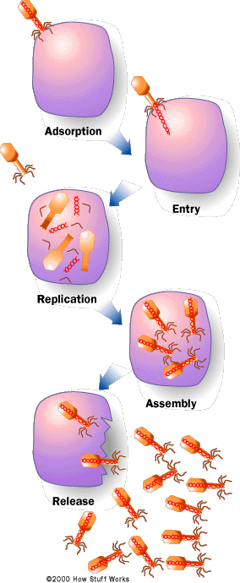
The Lytic Cycle
In the lytic cycle, a virus injects DNA into the host, causing the host to make more copies of the virus.
the host cell is destroyed as it releases new viruses that were assembled.

Slide 6
Stages of the Lytic Cycle
1. The virus attaches to the host cell
2. The virus injects its nucleic acid into the cell.

Slide 7
Stages of the Lytic Cycle
3. The viral nucleic acid takes over the host cell, causing it to make new virus parts (proteins & nucleic acids).
4. New viruses are assembled inside the host cell.

Slide 8
Stages of the Lytic Cycle
5. The new viruses destroy the host cell as they exit. Each virus can then infect another host cell.
The Flu: http://www.youtube.com/watch?v=Rpj0emEGShQ

Slide 9
Lytic vs Lysogenic Viruses
When a person has a lytic viral infection they typically show symptoms quicker than if they had a lysogenic viral infection.

Slide 10
The Lysogenic Cycle
In the lysogenic cycle, a virus injects DNA into the host and the viral DNA becomes part of the host cell’s DNA.
Every time the host cell divides, the viral DNA is also copied.
NEW VIRUSES ARE NOT MADE IN THE LYSOGENIC CYCLE!!

Slide 11
Stages of the Lysogenic Cycle
1. The virus attaches to the host cell
2. The virus injects its nucleic acid into the cell.

Slide 12
Lysogenic Cycle
3. The viral nucleic acid is incorporated into the host DNA.
4. When the cell divides, a copy of the viral genome is also made.

Slide 13
NO NEW VIRUSES ARE MADE!!

Slide 14
Lysogenic Cycle eventually becomes Lytic Cycle
An event may happen to cause Lysogenic viruses such as HIV to enter the Lytic cycle.
The HIV virus goes unnoticed while damaging or killing immune system’s T cells and causing them to make copies of itself.

Slide 15
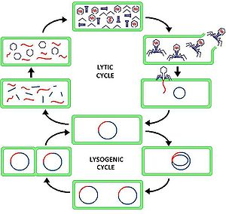

Slide 16
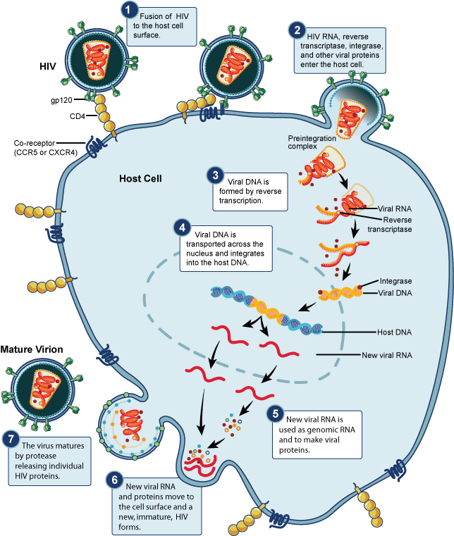

Slide 17
West Nile
West Nile: http://video.nationalgeographic.com/video/science/health-human-body-sci/health/virus-crisis-sci/

Slide 18
Review Questions!
What two biomolcules are in both viruses and cells?
What are similarities between cells and viruses?
What are differences between cells and viruses?
How are the lysogenic and lytic cycles the same?
How are the lysogenic and lytic cycles different?

